Slide 1
IV. EMPIRICAL ILLUSTRATION:
EMPLOYER-PROVIDED HEALTH INSURANCE

Slide 2
A.
Data and Environment
B.
Variation in Prices
IV.
C.
Empirical Strategy and Relationship with the Theoretical Framework
D.
Baseline Results
E.
Welfare Analyses

Slide 3
IV.A. Data and Environment
Data：individual-level data from 2004 on the U.S.-based employees (and
their dependents) at Alcoa, Inc(美国铝业公司).
Purpose of the application: theoretical framework can be mapped into empirical welfare estimates.
TOPIC HEAER ONE
We have many PowerPoint templates that has bee specifically designed.
Description :2004—— Alcoa
Approximately 45,000 active employees in the United States
300 different job sites in 39 different states.
A a new set of health insurance options
For all its salaried employees and about one-half of its hourly employees.
Over the subsequent several years——Contracts variation
(most of the remaining hourly employees were transitioned to the new health insurance options as their union contracts expired. )
TOPIC HEADER TWO
We have many PowerPoint templates that has been specifically designed.

Slide 4
IV.A. Data and Environment
Data details：
1.the menu of health insurance options(健康保险项目菜单)
2.the employee premium associated with each option(雇员保费)
3.the employee’s coverage choice(保险范围)
4.detailed claim-level information on all the employee (dependents’) medical expenditures during the coverage period(索赔等级)
(Health insurance choices are made during the “open enrollment” period at the end of 2003 and apply for all of 2004. We also observe medical expenditure in 2003 if the employee worked at the company for all of 2003.)
5. Insurance contracts offered to otherwise similar employees within the company——exogenous variation in the prices(below).
6. Rich demographic information——employee’s age, race, gender, annual earnings, and job tenure at the company and the number and ages of other insured family members.
TOPIC HEAER ONE
We have many PowerPoint templates that has bee specifically designed.
TOPIC HEADER TWO
We have many PowerPoint templates that has been specifically designed.

Slide 5
IV.A. Data and Environment
An assumption——We can observe
Everything about the employee
(Without direct personal contact——the administrators setting insurance premiums can observe)
Some characteristics the price setters might not be able to observe
(Detailed medical expenditure information from previous years;
Information administered by a third party)
TOPIC HEAER ONE
We have many PowerPoint templates that has bee specifically designed.
Important——examine whether have a correlation?
employee characteristics
the variation in prices across employees appears
influence the price setters’ decisions

Slide 6
IV.A. Data and Environment
baseline analysis: subsample of employees
——the pricing variation cleaner
——more closer to the the theoretical framework
TOPIC HEAER ONE
We have many PowerPoint templates that has bee specifically designed.
a higher level of PPO coverage
3,779 salaried employees with family coverage
Refer to Contract H
Choose one
a lower level of PPO coverage
Refer to Contract C

Slide 7
IV.B. Variation in Prices
Company Structure as the Source of Variation
An essential element——variation across employees in the relative price (face for contract H)
Willingness to pay for contract H
TOPIC HEAER ONE
We have many PowerPoint templates that has bee specifically designed.
Price variation
Insurable costs
Otherwise——Simultaneous causality！
Alcoa’s business structure ——a credible source of such pricing variation
across different employees in the company.

Slide 8
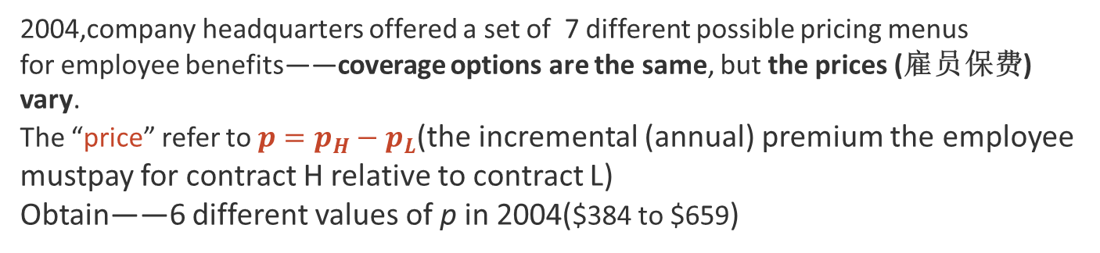
IV.B. Variation in Prices
Company Structure as the Source of Variation
2004,company headquarters offered a set of 7 different possible pricing menus
for employee benefits——coverage options are the same, but the prices (雇员保费) vary.
The “price” refer to $p=p_{H}−p_{L}$(the incremental (annual) premium the employee mustpay for contract H relative to contract L)
Obtain——6 different values of p in 2004($384 to $659)
Details on business structure :
Price menu a given employee faces is determined by the president of his business unit(业务部门主管).
40 business units；independence to run；Organized by functionality(功能)；Independent of geography(often multiple business units in the same state)；Active employees(range from the low teens(十几个)to 6000)；

Slide 9
IV.B. Variation in Prices
Company Structure as the Source of Variation
President choose different price menus based on location(职位) and employment type(雇佣类型).
SO employees doing the same job in the same location may face different prices due to their business unit affiliations.
Employment type(雇佣类型)——the pricing variation across salaried employees in different business units more likely to be useful for identification than hourly employees.
TOPIC HEAER ONE
We have many PowerPoint templates that has bee specifically designed.
salaried employees
hourly employees
TOPIC HEADER TWO
We have many PowerPoint templates that has been specifically designed.
Similar jobs across business units
(accountants, paralegals, administrative assistants, electrical engineers, or metallurgists)
价格更可能由自己部门的业务主管决定。
differ across different units——depend on what the business unit is producing
Choose it!

Slide 10
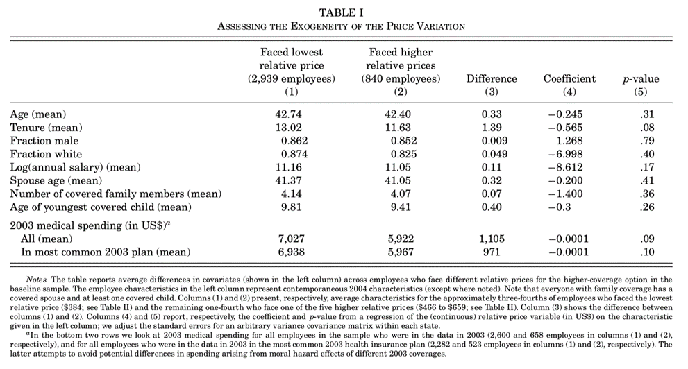
IV.B. Variation in Prices
Examination of Assumption of Exogenous Pricing
Compares mean demographic characteristics of employees in our baseline sample (all salaried) who face different prices.

Slide 11
IV.B. Variation in Prices
Examination of Assumption of Exogenous Pricing
Result: balanced
No substantive
or statistically significant difference.
Two possible
Exceptions
(when ten different variables are tested
the p-value should be adjusted upward to take account of the multiple hypothesis
testing)

Slide 12
IV.B. Variation in Prices
Examination of Assumption of Exogenous Pricing
A joint F-test of all of the coefficients : leaves us unable to reject the null that they are jointly uncorrelated with
Price.
state fixed effects
or
extend the sample to include all coverage tiers or all salaried employees.

Slide 13
IV.B. Variation in Prices
Examination of Assumption of Exogenous Pricing
2004 was the first year ever when business unit presidents had the opportunity to make decisions regarding the relative prices of insurance contracts .
SO to the decision makers
little information or experience
opposed to charging employees much for (generous)(高额) health insurance coverage.
That’s WHY——about 3/4 of the salaried employees ended up facing the lowest possible incremental price that the business unit presidents were allowed to choose.
TOPIC HEAER ONE
We have many PowerPoint templates that has bee specifically designed.

Slide 14
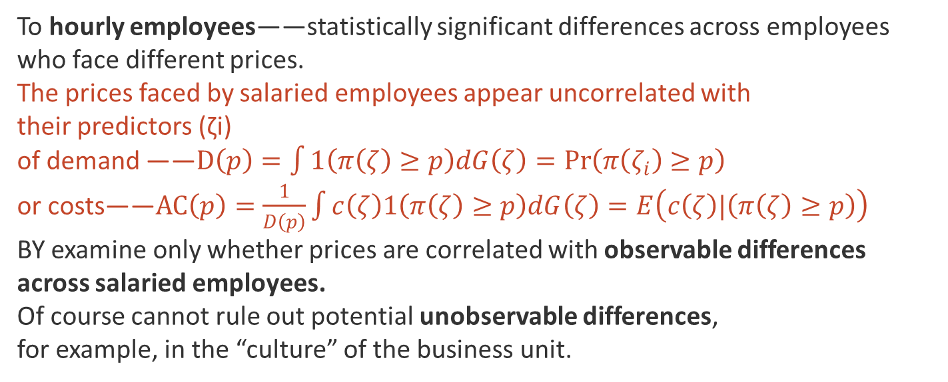
IV.B. Variation in Prices
Examination of Assumption of Exogenous Pricing
To hourly employees——statistically significant differences across employees who face different prices.
The prices faced by salaried employees appear uncorrelated with
their predictors (ζi)
of demand ——$D\left(p\right)=\int{1\left(π\left(ζ\right)≥p\right)dG\left(ζ\right)}=Pr\left(π\left(ζ_{i}\right)≥p\right)$
or costs——$AC\left(p\right)=\frac{1}{D\left(p\right)}\int{c\left(ζ\right)1\left(π\left(ζ\right)≥p\right)dG\left(ζ\right)=E\left(c\left(ζ\right)|\left(π\left(ζ\right)≥p\right)\right)}$
BY examine only whether prices are correlated with observable differences across salaried employees.
Of course cannot rule out potential unobservable differences,
for example, in the “culture” of the business unit.
TOPIC HEAER ONE
We have many PowerPoint templates that has bee specifically designed.

Slide 15
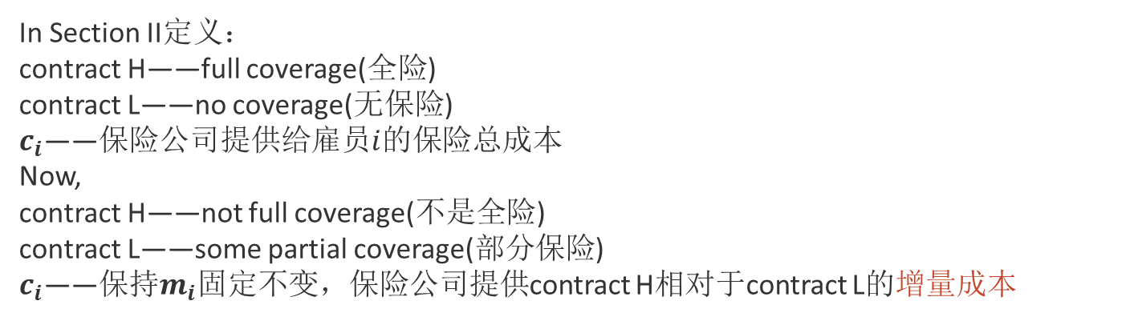
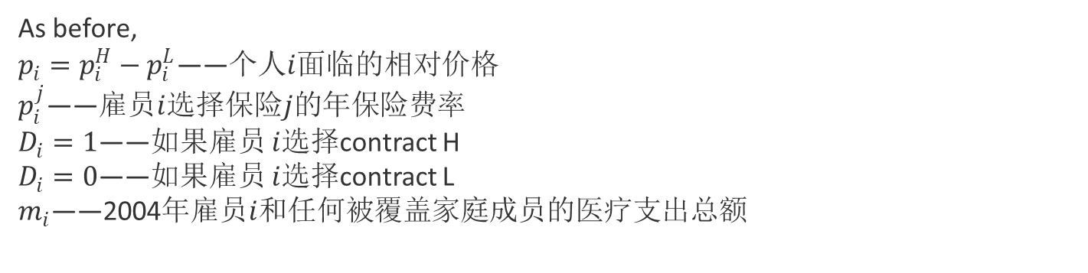
IV.C. Empirical Strategy and Relationship with the Theoretical Framework
Coverage Characteristics and Construction of the Cost Variable
As before,
$p_{i}=p_{i}^{H}−p_{i}^{L}$——个人$i$面临的相对价格
$p_{i}^{j}$——雇员$i$选择保险$j$的年保险费率
$D_{i}=1$——如果雇员 $i$选择contract H
$D_{i}=0$——如果雇员 $i$选择contract L
$m_{i}$——2004年雇员$i$和任何被覆盖家庭成员的医疗支出总额
TOPIC HEAER ONE
We have many PowerPoint templates that has bee specifically designed.
In Section II定义：
contract H——full coverage(全险)
contract L——no coverage(无保险)
$c_{i}$——保险公司提供给雇员$i$的保险总成本
Now,
contract H——not full coverage(不是全险)
contract L——some partial coverage(部分保险)
$c_{i}$——保持$m_{i}$固定不变，保险公司提供contract H相对于contract L的增量成本
TOPIC HEADER TWO
We have many PowerPoint templates that has been specifically designed.

Slide 16
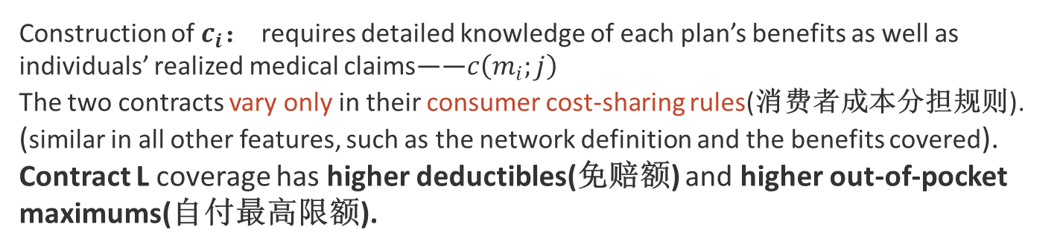
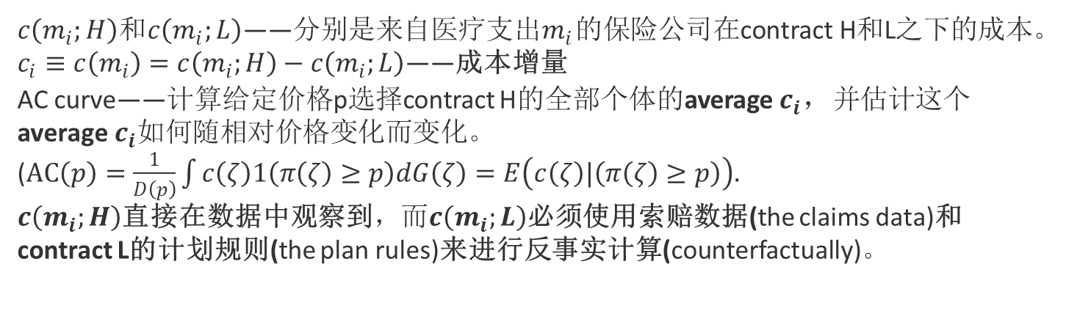
IV.C. Empirical Strategy and Relationship with the Theoretical Framework
Coverage Characteristics and Construction of the Cost Variable
$c\left(m_{i};H\right)$和$c\left(m_{i};L\right)$——分别是来自医疗支出$m_{i}$的保险公司在contract H和L之下的成本。
$c_{i}≡c\left(m_{i}\right)=c\left(m_{i};H\right)−c\left(m_{i};L\right)$——成本增量
AC curve——计算给定价格p选择contract H的全部个体的average$c_{i}$，并估计这个average$c_{i}$如何随相对价格变化而变化。
($AC\left(p\right)=\frac{1}{D\left(p\right)}\int{c\left(ζ\right)1\left(π\left(ζ\right)≥p\right)dG\left(ζ\right)=E\left(c\left(ζ\right)|\left(π\left(ζ\right)≥p\right)\right).}$
$c\left(m_{i};H\right)$直接在数据中观察到，而$c\left(m_{i};L\right)$必须使用索赔数据(the claims data)和contract L的计划规则(the plan rules)来进行反事实计算(counterfactually)。
TOPIC HEAER ONE
We have many PowerPoint templates that has bee specifically designed.
Construction of $c_{i}$： requires detailed knowledge of each plan’s benefits as well as individuals’ realized medical claims——$c\left(m_{i};j\right)$
The two contracts vary only in their consumer cost-sharing rules(消费者成本分担规则). (similar in all other features, such as the network definition and the benefits covered).
Contract L coverage has higher deductibles(免赔额) and higher out-of-pocket maximums(自付最高限额).
TOPIC HEADER TWO
We have many PowerPoint templates that has been specifically designed.

Slide 17
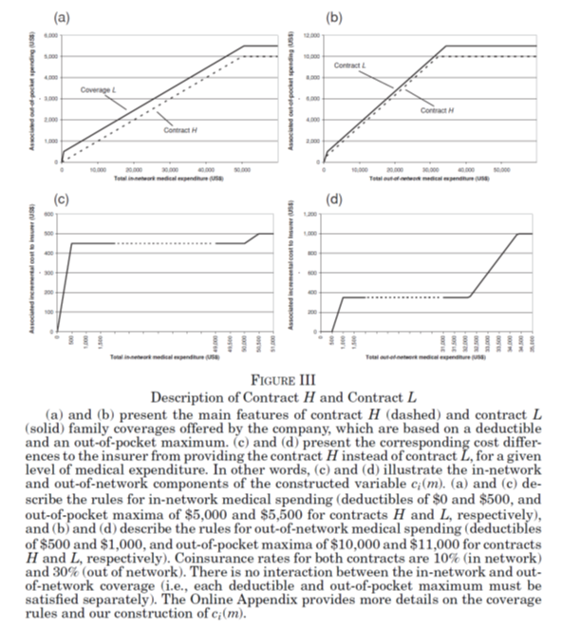
IV.C. Empirical Strategy and Relationship with the Theoretical Framework
Coverage Characteristics and Construction of the Cost Variable
Show us：
Major differences in consumer cost
sharing between the two coverage options.
Cost-sharing rules differ depending on whether spending is in-network or out-of-network.(Although the vast majority of spending (96%) occurs in-network, about 25% of the individuals in our baseline sample file at least one claim out of network, making the out-of-network coverage an important part of the analysis)
TOPIC HEAER ONE
We have many PowerPoint templates that has bee specifically designed.
TOPIC HEADER TWO
We have many PowerPoint templates that has been specifically designed.

Slide 18
IV.C. Empirical Strategy and Relationship with the Theoretical Framework
Coverage Characteristics and Construction of the Cost Variable
5500
11000
TOPIC HEAER ONE
We have many PowerPoint templates that has bee specifically designed.
K=0.1
K=0.3
500
500
1000
TOPIC HEADER TWO
We have many PowerPoint templates that has been specifically designed.
deductibles of $0 and $500,
out-of-pocket maxima of $5,000 and $5,500 for contracts H and L, respectively.
Deductibles of $500 and $1,000,
out-of-pocket maxima of $10,000 and $11,000 for contractsH and L, respectively.
Coinsurance rates:10%
Coinsurance rates:30%

Slide 19
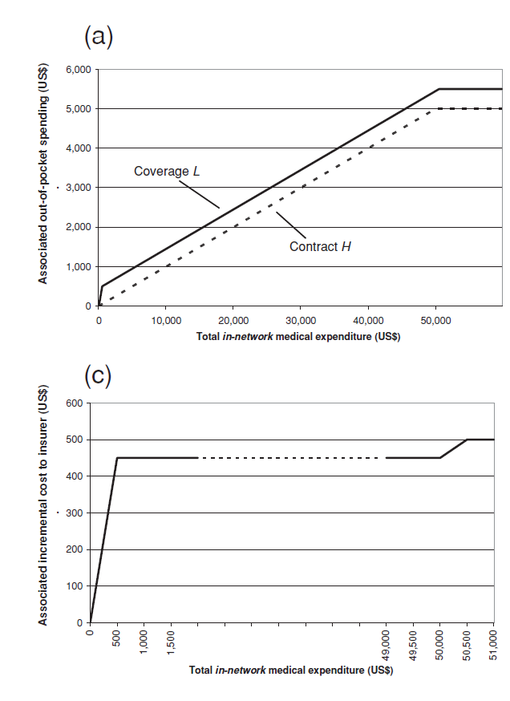
IV.C. Empirical Strategy and Relationship with the Theoretical Framework
Coverage Characteristics and Construction of the Cost Variable
Show(in-network)：corresponding cost differences to the insurer from providing the contract H instead of contract L (给定m).
分析：m(0-500)： 购买H，保险公司赔偿90%;
购买L，未达到免赔额500，完全自付，赔付0%;
m(500-50000)： 购买H，保险公司赔偿90%;
购买L，保险公司赔偿90%；
m(50000-55000)： 购买H，保险公司赔偿100%;
购买L，保险公司赔偿90%；
m(55000以上)： 购买H，保险公司赔偿100%;
购买L，保险公司赔偿100%；
即，c的斜率是购买H和购买L赔付率的差值。
0.1
0.9
TOPIC HEADER TWO
We have many PowerPoint templates that has been specifically designed.

Slide 20
IV.C. Empirical Strategy and Relationship with the Theoretical Framework
Coverage Characteristics and Construction of the Cost Variable
Show(out-of-network)：corresponding cost differences to the insurer from providing the contract H instead of contract L (给定m).
分析：m(0-500)： 购买H，未达到免赔额500，保险公司赔偿0%;
购买L，未达到免赔额1000，完全自付，赔付0%;
m(500-1000)： 购买H，保险公司赔偿70%;
购买L，未达到免赔额1000，完全自付，赔付0%;
m(1000-32166)： 购买H，保险公司赔偿70%;
购买L，保险公司赔偿70%；
m(32166-34333)： 购买H，保险公司赔偿100%;
购买L，保险公司赔偿70%；
m(34333以上)： 购买H，保险公司赔偿100%;
购买L，保险公司赔偿100%；
即，c的斜率是购买H和购买L赔付率的差值。
0.3
TOPIC HEADER TWO
We have many PowerPoint templates that has been specifically designed.
0.7

Slide 21
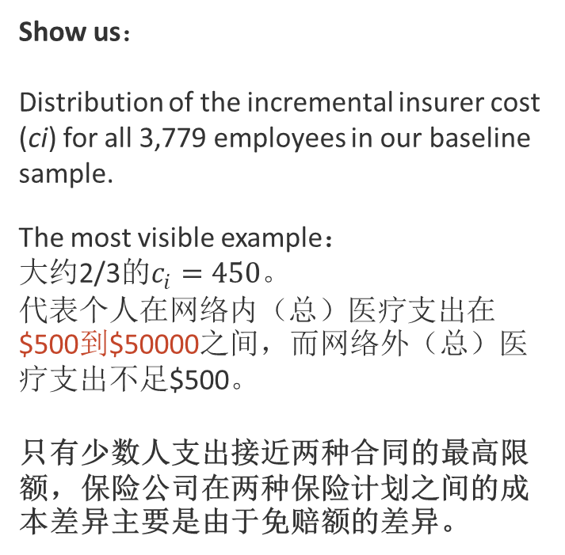
IV.C. Empirical Strategy and Relationship with the Theoretical Framework
Coverage Characteristics and Construction of the Cost Variable
Show us：
Distribution of the incremental insurer cost (ci) for all 3,779 employees in our baseline sample.
The most visible example：
大约2/3的$c_{i}=450$。
代表个人在网络内（总）医疗支出在$500到$50000之间，而网络外（总）医疗支出不足$500。
只有少数人支出接近两种合同的最高限额，保险公司在两种保险计划之间的成本差异主要是由于免赔额的差异。
TOPIC HEAER ONE
We have many PowerPoint templates that has bee specifically designed.
TOPIC HEADER TWO
We have many PowerPoint templates that has been specifically designed.

Slide 22
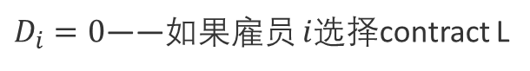
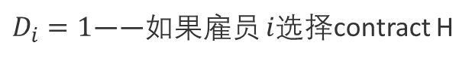

IV.C. Empirical Strategy and Relationship with the Theoretical Framework
Baseline Estimating Equations
OLS——assuming that the demand and cost curves are each linear in prices.
Estimate：
(11) $D_{i}=α+βp_{i}+ε_{i}$.
(12) $c_{i}=γ+δp_{i}+u_{i}.$
$D_{i}=1$——如果雇员 $i$选择contract H
$D_{i}=0$——如果雇员 $i$选择contract L
$c_{i}$——来自覆盖contract H而不是contract L的个人$i$的保险公司可实现的增量成本
$p_{i}$——是雇员$i$购买H(而不是L)需要支付的增量年保费
Adjust the standard errors to allow for an arbitrary variance-covariance matrix within each state.
The demand equation is estimated on the entire sample, whereas the (average) cost equation is estimated on the sample of individuals who (endogenously) choose contract H.

Slide 23
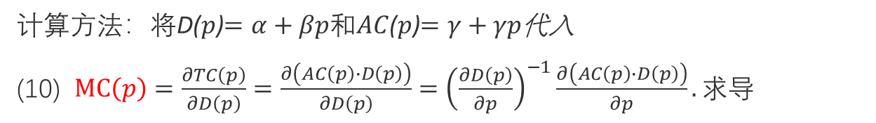
IV.C. Empirical Strategy and Relationship with the Theoretical Framework
Baseline Estimating Equations
OLS——assuming that the demand and cost curves are each linear in prices.
Estimate：
(11) $D_{i}=α+βp_{i}+ε_{i}$.
(12) $c_{i}=γ+δp_{i}+u_{i}.$
Using the point estimates from the above regressions, we can construct our predicted demand and average cost curves and other estimates of interest.(根据点估计，构建函数)
The marginal cost
(13) $MC\left(p\right)=\frac{1}{β}\left(\frac{∂\left(α+βp\right)\left(γ+δp\right)}{∂p}\right)=\frac{1}{β}\left(αδ+γβ+2βδp\right)=\frac{αδ}{β}+γ+2δp.$
计算方法：将D($p$)$=α+βp和AC$($p$)$=γ+γp$代入
(10) $MC\left(p\right)=\frac{∂TC\left(p\right)}{∂D\left(p\right)}=\frac{∂\left(AC\left(p\right)∙D\left(p\right)\right)}{∂D\left(p\right)}={\left(\frac{∂D\left(p\right)}{∂p}\right)}^{−1}\frac{∂\left(AC\left(p\right)∙D\left(p\right)\right)}{∂p}.求导$

Slide 24
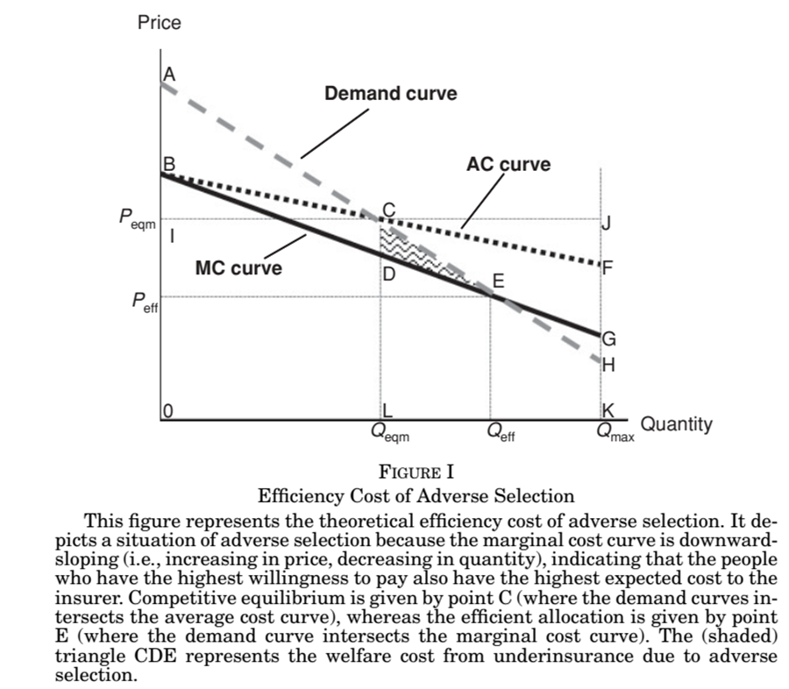
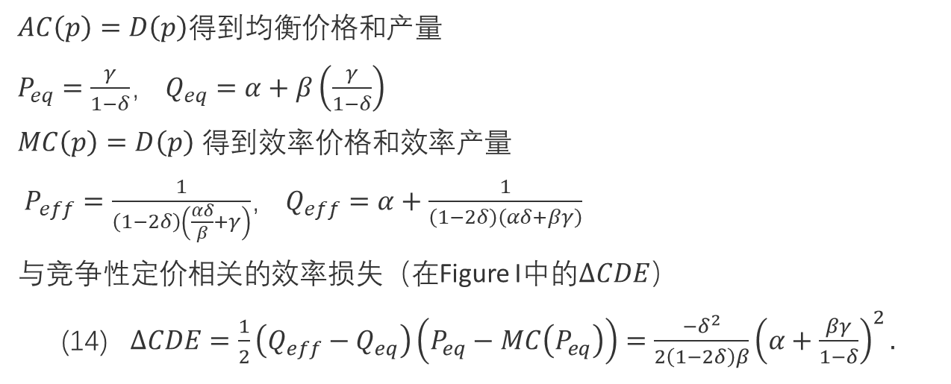
IV.C. Empirical Strategy and Relationship with the Theoretical Framework
Baseline Estimating Equations
$\text{With}D\left(p\right)$，$AC\left(p\right)$，$MC\left(p\right)$
$AC\left(p\right)=D\left(p\right)$得到均衡价格和产量
$P_{eq}=\frac{γ}{1−δ}$， $Q_{eq}=α+β\left(\frac{γ}{1−δ}\right)$
$MC\left(p\right)=D\left(p\right)$ 得到效率价格和效率产量
$P_{eff}=\frac{1}{\left(1−2δ\right)\left(\frac{αδ}{β}+γ\right)}$， $Q_{eff}=α+\frac{1}{\left(1−2δ\right)\left(αδ+βγ\right)}$
与竞争性定价相关的效率损失（在Figure I中的$∆CDE$）
(14) $∆CDE=\frac{1}{2}\left(Q_{eff}−Q_{eq}\right)\left(P_{eq}−MC\left(P_{eq}\right)\right)=\frac{−δ^{2}}{2\left(1−2δ\right)β}{\left(α+\frac{βγ}{1−δ}\right)}^{2}.$

Slide 25
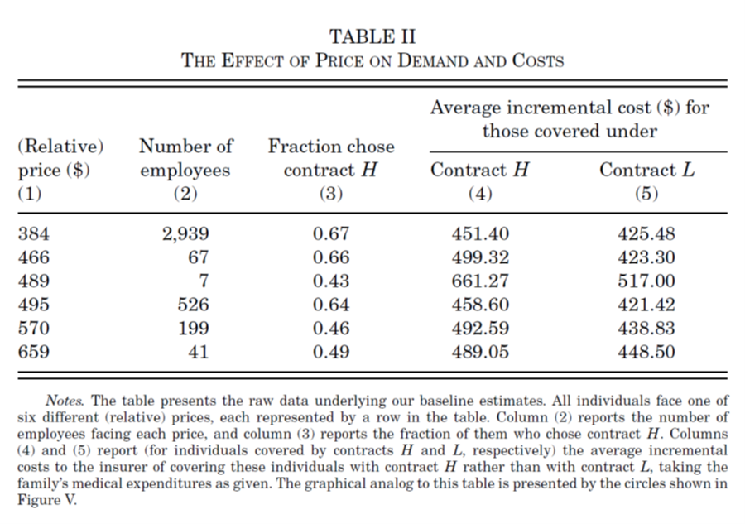
IV.D. Baseline Results
(1)The (relative) price ranges from $384 to $659.
(3) the propensity to choose contract H is generally declining with price and ranges from 0.67 to 0.43.
(4) The average costs of the (endogenously selected) individuals who select contract H is generally increasing with price (or equivalently, declining in quantity.
(5)The same for L.
(4)And(5) reveals consistently higher average costs for those covered by contract H than for those covered by contract L. (moral hazard or adverse selection is present)
TOPIC HEAER ONE
We have many PowerPoint templates that has bee specifically designed.
TOPIC HEADER TWO
We have many PowerPoint templates that has been specifically designed.

Slide 26

IV.D. Baseline Results
downward-sloping demand curve——statistically significant slope coefficient
−0.00070：a $100 increase in price reduces the probability that the employee chooses contract H by a statistically significant 7%, or about 11%.
(2) statistically significant slope coefficient
0.155:indicates the presence of adverse selection.
$1 dollar increase in the relative price of contract H is associated with an increase in the average cost of the (endogenous) sample selecting contract H at that price of about 16 cents.
当价格选择了那些对H具有更高平均支付意愿的人,这一组的平均成本也越高。因此，平均成本曲线是斜向下倾斜的。
TOPIC HEAER ONE
We have many PowerPoint templates that has bee specifically designed.
𝛽
$$δ$$
TOPIC HEADER TWO
We have many PowerPoint templates that has been specifically designed.

Slide 27
IV.D. Baseline Results
plotting the estimated demand and average cost curves, as well as the marginal cost curve
$9.55 ：the welfare cost associated with competitive pricing per employee per year.
TOPIC HEAER ONE
We have many PowerPoint templates that has bee specifically designed.
$200： Adverse selection raises the equilibrium price above the efficient price(比较E点的估计有效价格和C点的估计均衡价格).
14%:lowers the share of contract H by fourteen percentage points.(0.756-0.617=0.139)
$138:提供contract H给在均衡点购买contract L的边际雇员的社会福利是$138(CD)
TOPIC HEADER TWO
We have many PowerPoint templates that has been specifically designed.

Slide 28
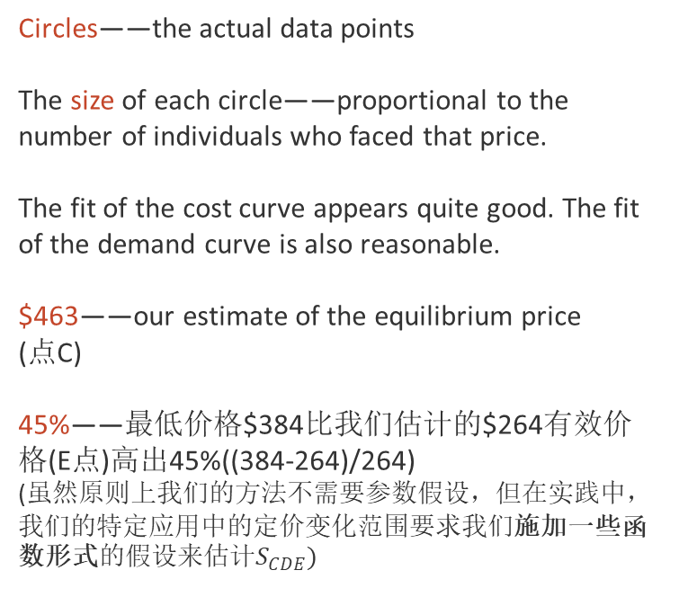
IV.D. Baseline Results
plotting the estimated demand and average cost curves, as well as the marginal cost curve
some useful information:
Circles——the actual data points
The size of each circle——proportional to the number of individuals who faced that price.
The fit of the cost curve appears quite good. The fit of the demand curve is also reasonable.
$463——our estimate of the equilibrium price
(点C)
45%——最低价格$384比我们估计的$264有效价格(E点)高出45%((384-264)/264)
(虽然原则上我们的方法不需要参数假设，但在实践中，我们的特定应用中的定价变化范围要求我们施加一些函数形式的假设来估计$S_{CDE})$
TOPIC HEADER TWO
We have many PowerPoint templates that has been specifically designed.

Slide 29
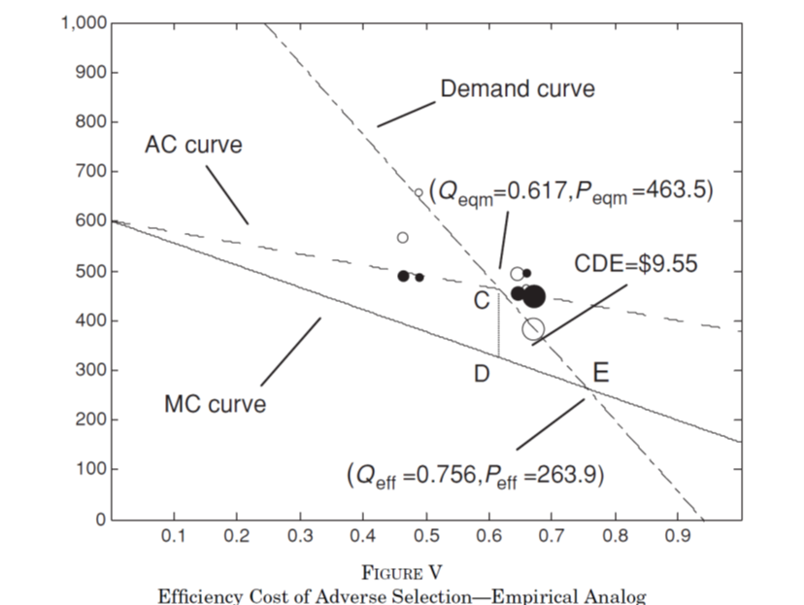
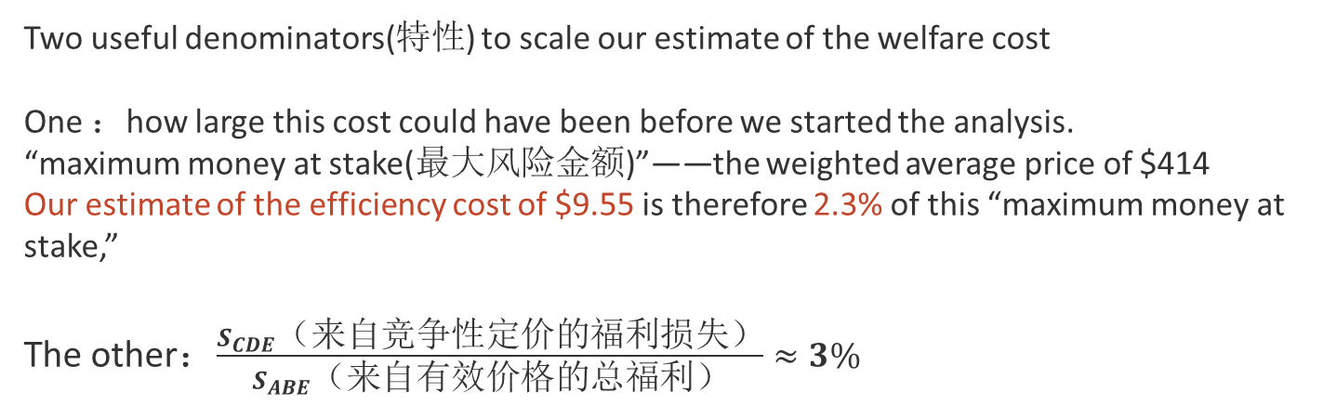
IV.E. Welfare Analyses
Benchmarks for Our Welfare Cost Estimates(福利损失估计的基准)
Two useful denominators(特性) to scale our estimate of the welfare cost
One ：how large this cost could have been before we started the analysis.
“maximum money at stake(最大风险金额)”——the weighted average price of $414
Our estimate of the efficiency cost of $9.55 is therefore 2.3% of this “maximum money at stake,”
The other：$\frac{S_{CDE}（来自竞争性定价的福利损失）}{S_{ABE}（来自有效价格的总福利）}≈3\%$
TOPIC HEAER ONE
We have many PowerPoint templates that has bee specifically designed.
Concerns about extrapolating too far out of sample

Slide 30
IV.E. Welfare Analyses
Welfare under Other Market Allocations(其他市场分配下的福利分配)
To generate our pricing variation we observed a market that is not in equilibrium. Our analysis of “equilibrium” pricing, like our analysis of “efficient” pricing, is based on a counterfactual.
TOPIC HEAER ONE
We have many PowerPoint templates that has bee specifically designed.
we could also use the estimated demand and cost curves to estimate welfare under alternative assumptions about the market equilibrium, including monopoly or imperfect competition.
If competitive prices were set based on some observable characteristics of the employees.
Set prices differently for each market segment(对每个细分市场的价格进行不同的设置).

Slide 31
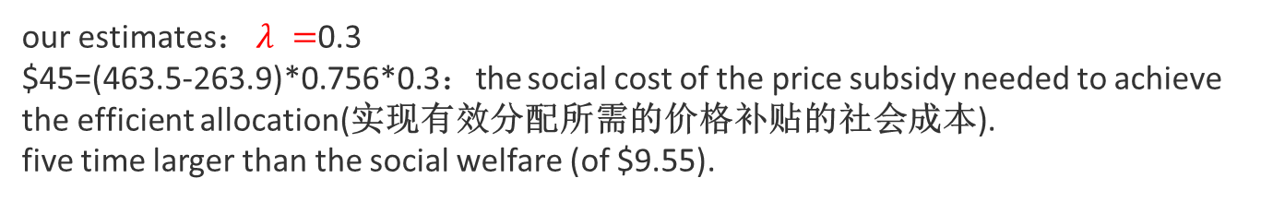
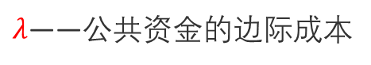
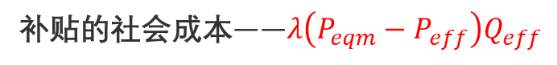
IV.E. Welfare Analyses
Welfare Consequences of Government Intervention(政府介入的福利结果 )
Estimate the welfare cost of standard public policy interventions in insurance markets.
price subsidies(价格补贴)
coverage mandates(强制保险)
regulation of the characteristics of individuals(个人特征监管)
补贴的社会成本——$λ\left(P_{eqm}−P_{eff}\right)Q_{eff}$
$λ$——公共资金的边际成本
our estimates： $λ =$0.3
$45=(463.5-263.9)*0.756*0.3：the social cost of the price subsidy needed to achieve the efficient allocation(实现有效分配所需的价格补贴的社会成本).
five time larger than the social welfare (of $9.55).
Welfare maximizing (additional) price subsidy by the government is 0.

Slide 32

V. CONCLUSIONS

Slide 33
V. CONCLUSIONS : Review
I. Introduction
II. Theoretical Framework
II.A. Model
Setup and Notation
Demand for Insurance
II.B. Measuring Welfare
II.C. Graphical Representation
Adverse Selection
Advantageous Selection
Sufficient Statistic for Welfare Analysis
II.D. Incorporating Moral Hazard
III. Estimation
III.A. The Basic Framework
III.B. Extensions
III.C. A Direct Test of Selection
III.D. Estimating Moral Hazard
III.E. Applicability
IV. Empirical Illustration:Employer-Provided Health Insurance
IV.A. Data and Environment
IV.B. Variation in Prices
IV.C. Empircal Strategy and Relationship with the Theoretical Framework
Coverage Characteristics and Construction of the Cost Variable
Baseline Estimating Equations
IV.D. Baseline Results
IV.E. Welfare Analyses
Benchmarks for Our Welfare Cost Estimates
Welfare under Other Market Allocations
Welfare Consequences of Government Intervention
V. Conclusion

Slide 34
V. CONCLUSIONS
This paper proposes a simple approach to quantifying and estimating the welfare cost caused by inefficient pricing in insurance markets with selection.
We illustrated our framework by applying it in the context of employer-provided health insurance at a particular firm.
We find evidence of adverse selection in the market, but we estimate that the welfare cost of the resultant inefficient pricing is quantitatively small.

Slide 35
THANKS FOR
WATCHING!
The literature can be downloaded from https://doi.org/10.1162/qjec.2010.125.3.877.

